Slide 1
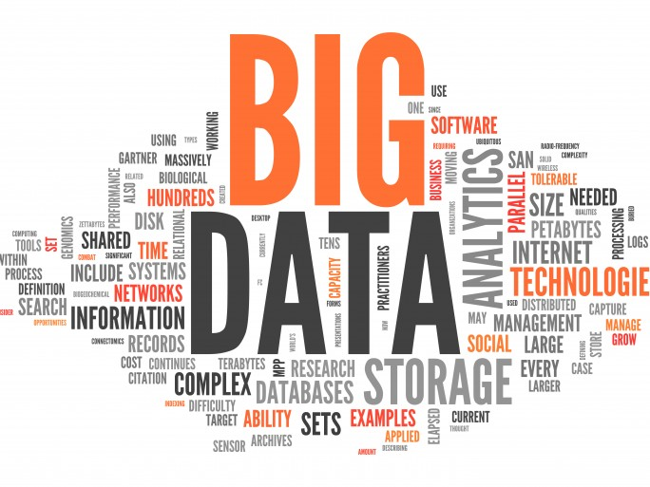
Introduction to Big Data
By
Ashwinkumar R

Slide 2
Agenda
What is Big Data
Characteristics of Big Data
Types of Big Data
Types of Data Analytics
Values and challenges in Big Data Analytics
Technologies used

Slide 3
Big Data Definition
No single standard definition…
'Big Data' is a term used to describe collection of data that is huge in size and yet growing exponentially with time.

Slide 4
https://www.youtube.com/watch?v=TzxmjbL-i4Y

Slide 5
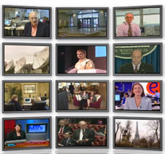
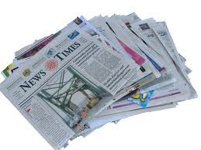
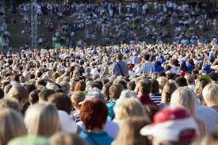

The Model Has Changed
The Model of Generating/Consuming data has changed
Old Model: Few companies are generating data, all others are consuming data.
New Model: All of us are generating data and all of us are consuming data.

Slide 6
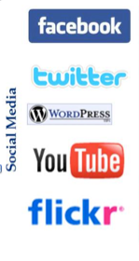
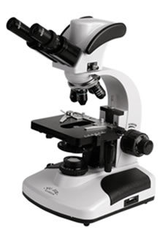
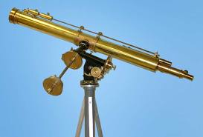
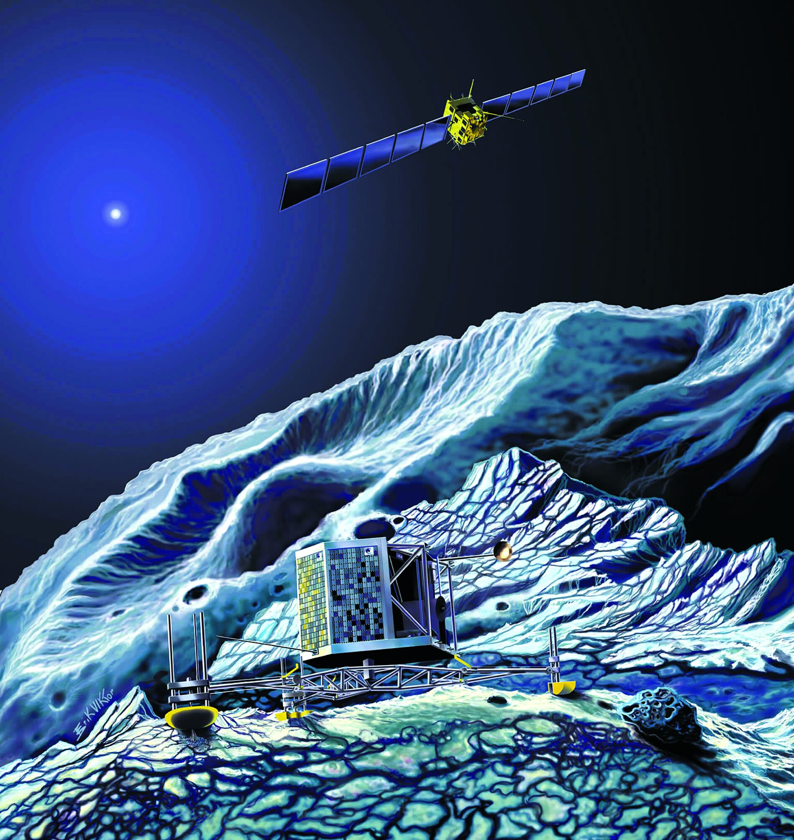

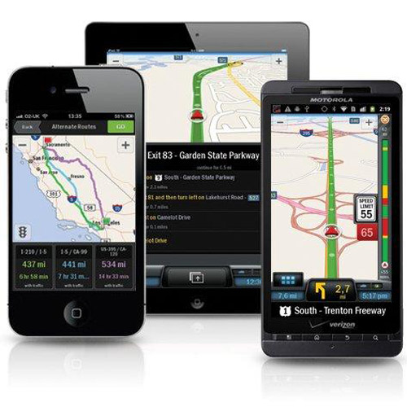
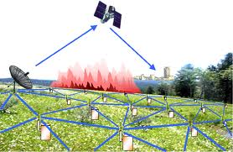

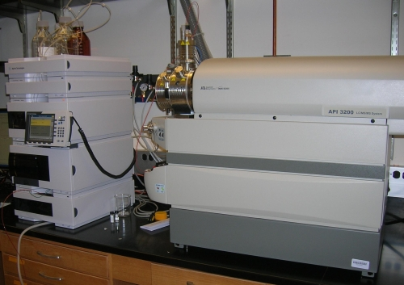
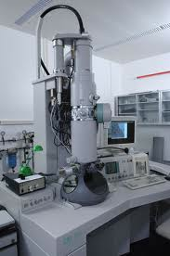
Who’s Generating Big Data
Mobile devices
(tracking all objects all the time)
Sensor technology and networks
(measuring all kinds of data)
Social media and networks
(all of us are generating data)
Scientific instruments
(collecting all sorts of data)
The progress and innovation is no longer hindered by the ability to collect data.
It is hindered by the ability to manage, analyze, summarize, visualize and discover knowledge from the collected data in a timely manner and in a scalable fashion.

Slide 7

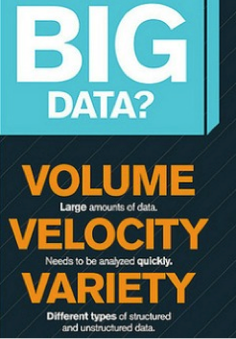
Big Data: 3V’s

Slide 8
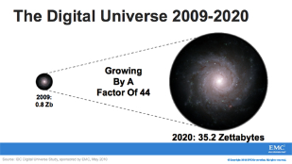
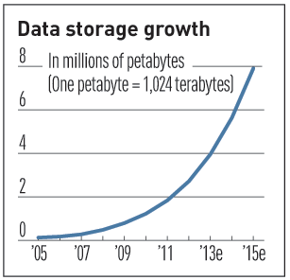

Characteristics of Big Data 1-Scale (Volume)
Data Volume
44x increase from 2009 to 2020
From 0.8 zettabytes to 35zb
Amount of data generated through websites, portals and online applications
Data volume is increasing exponentially

Slide 9
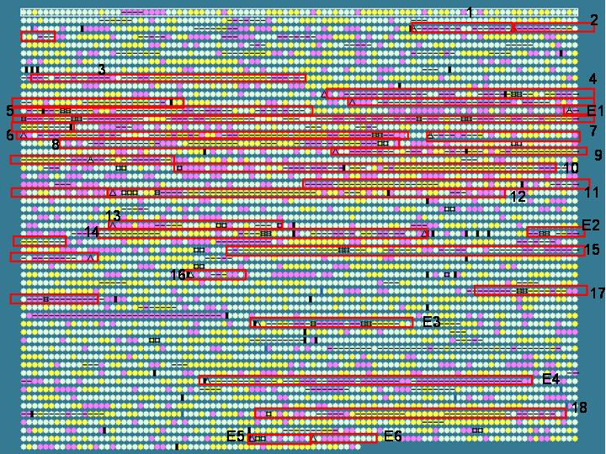
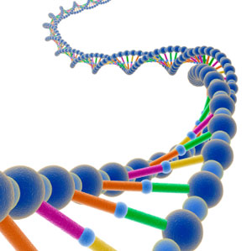
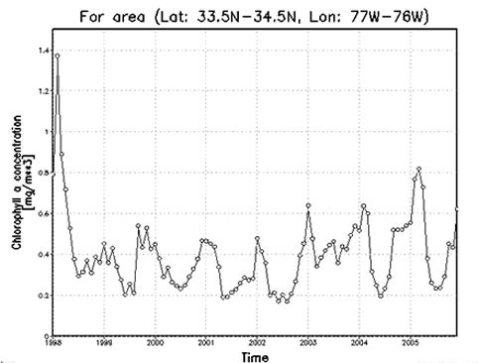

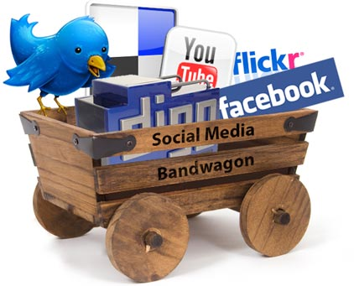
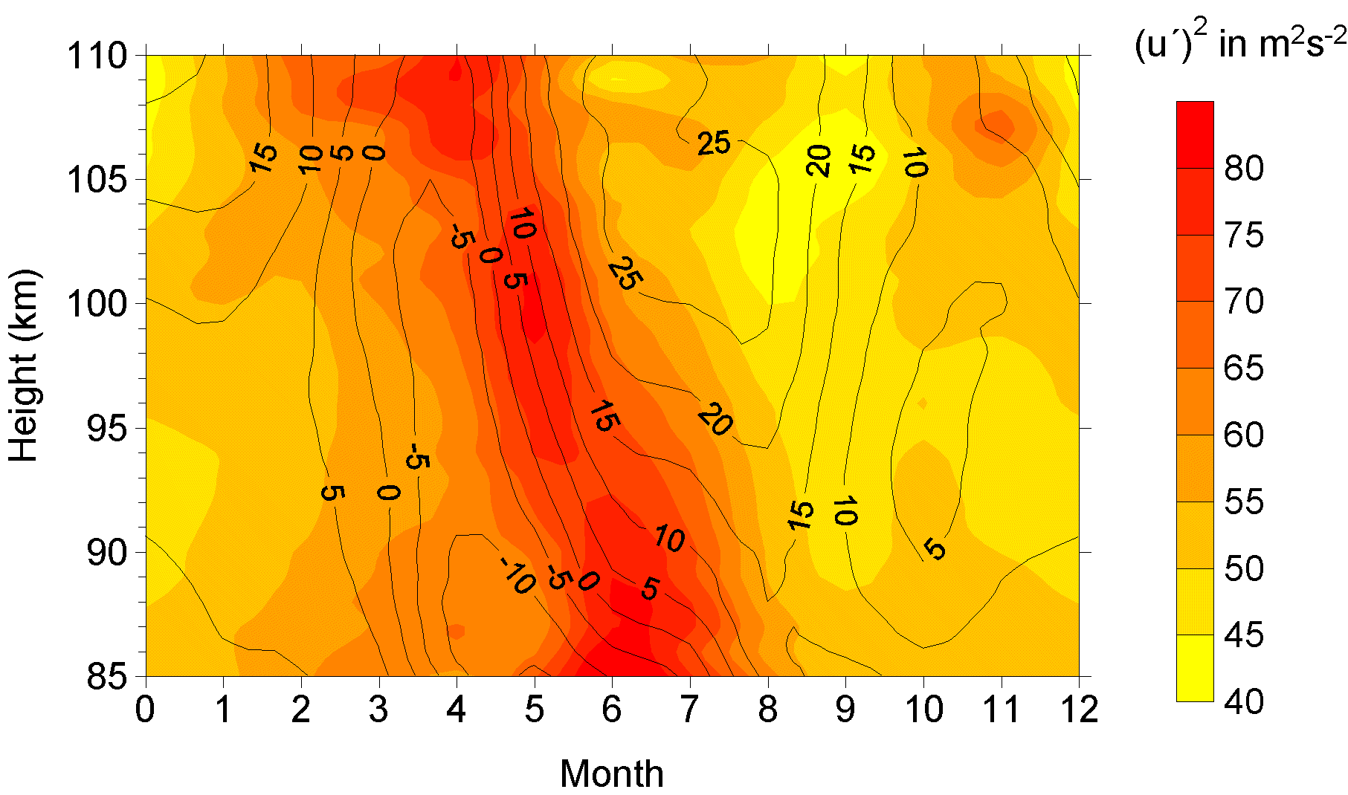
Characteristics of Big Data 2-Complexity (Variety)
Various formats, types and structures
Text, numerical, images, audio, video, sequences, time series, social media data, multi-dim arrays, etc…
Static data vs. streaming data
A single application can be generating/collecting many types of data
To extract knowledge ➔ all these types of data must be linked together

Slide 10
Characteristics of Big Data 3-Speed (Velocity)
Data is being generated fast and need to be processed fast
Online Data Analytics
Late decisions ➔ missing opportunities
Examples
E-Promotions: Based on your current location, your purchase history, what you like ➔ send promotions right now for store next to you.
Healthcare monitoring: Sensors monitoring your activities and body ➔ any abnormal measurements require immediate reaction.

Slide 11
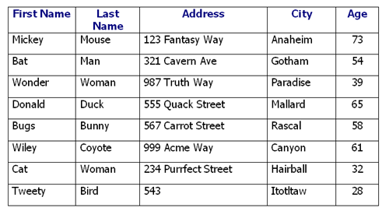
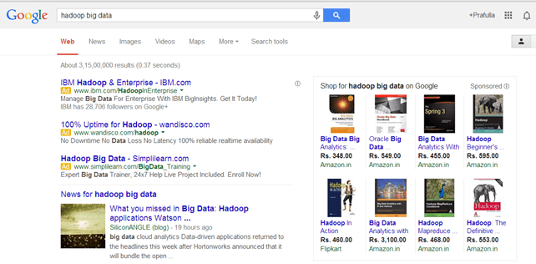
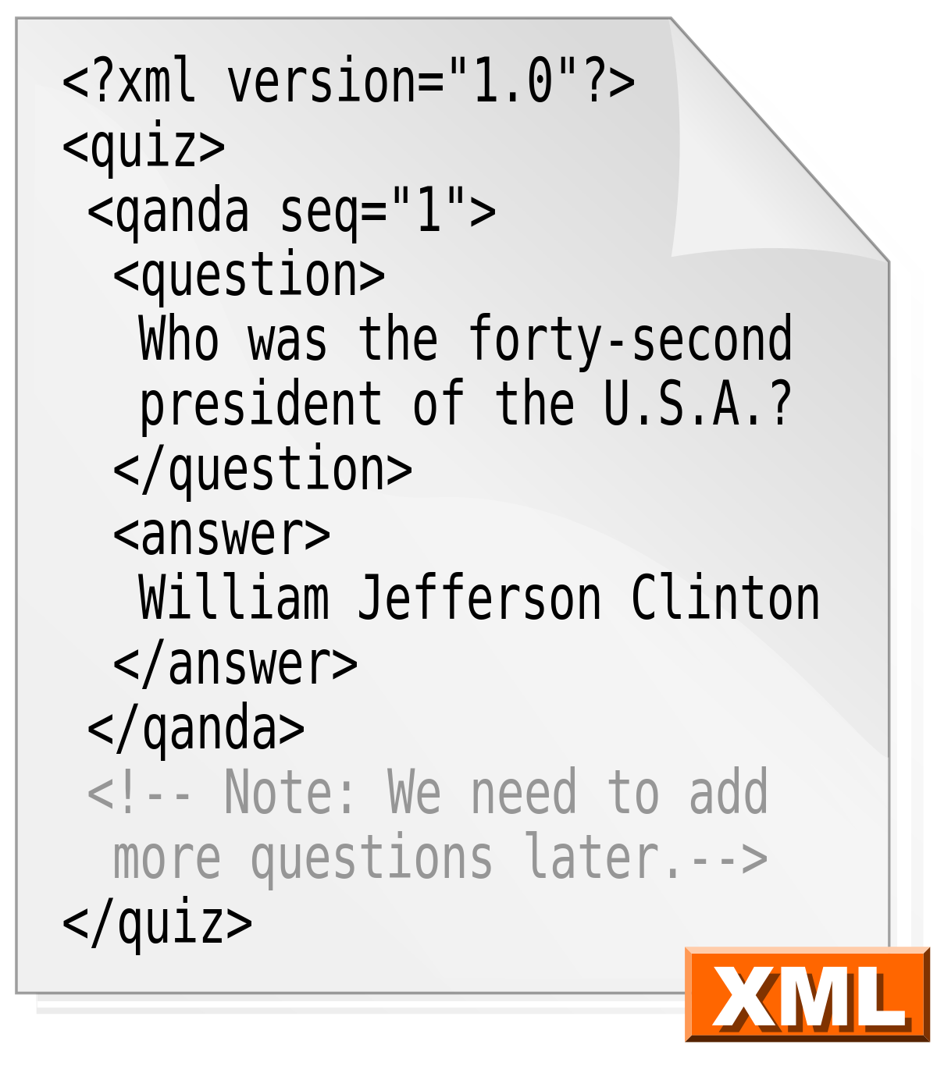
Types Of Big Data
Structured
An 'Employee' table in a database.
Unstructured
Output returned by 'Google Search’
Semi-structured
Personal data stored in an XML file

Slide 12
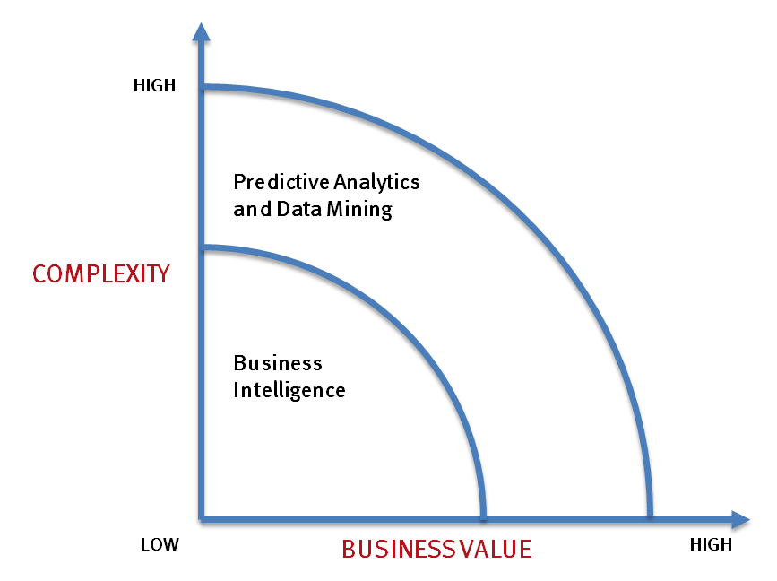
What’s driving Big Data
- Optimizations and predictive analytics
- Complex statistical analysis
- All types of data and many sources
- Very large datasets
- More of a real-time
- Data mining techniques
- Structured data, typical sources
- Small to mid-size datasets

Slide 13
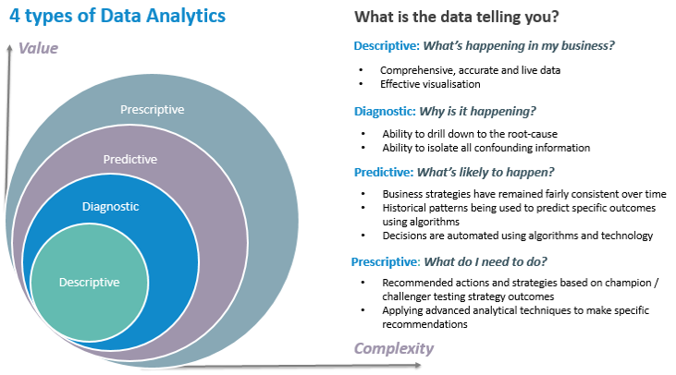
Types of Data Analytics

Slide 14
Big Data behind Amazon Recommendation System
https://www.youtube.com/watch?v=S4RL6prqtGQ&feature=youtu.be

Slide 15
Values of Big Data Analytics
Reasons | Big Data benefits
Better analytics | Improvement of business performance through real-time analytics
Vast amount of data | Big data technologies manage huge amounts of data
Insights | Can provide better insights with the help of structured and semi-structured data
Decision-making | Helps mitigate risk and make smart decision by proper risk analysis

Slide 16
Challenges in Handling Big Data
The Bottleneck is in technology
New architecture, algorithms, techniques are needed.
Technical skills
Expertise in using the new technology and dealing with big data.
Data quality
Dirty data is costing companies a lot each year.
Security
Keeping that vast lake of data secure is another big data challenge.

Slide 17
Facebook and Cambridge Analytica data breach
https://www.youtube.com/watch?v=mrnXv-g4yKU

Slide 18
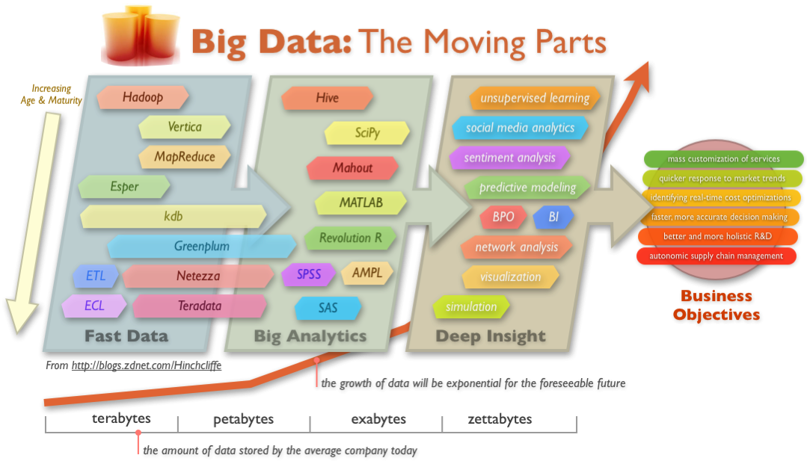
Big Data Technology

Slide 19
Thank You..☺

